Slide 1

Team Details
Team name : NextGen Innovators
Team leader name : Prajen SK
Problem Statement : Open Innovation in AI

Slide 2
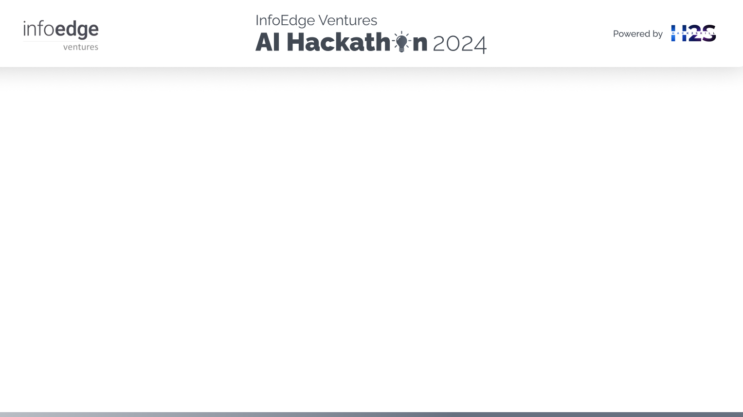
Brief about the idea :
HealthMate: Your Personal Health Ally.
Welcome to HealthMate, where your health is our priority! This revolutionary app transforms how you manage your well-being, offering a suite of features designed to keep you informed and healthy. Whether you're seeking a quick diagnosis, scheduling an appointment with a specialist, or accessing personalized health tips, HealthMate has you covered. With the ability to track your symptoms, consult with virtual doctors, and receive daily health insights, HealthMate empowers you to take control of your health like never before. Stay fit, informed, and connected with HealthMate—your ultimate health companion!

Slide 3
1. How different is it from any of the other existing ideas?
HealthMate combines AI-driven symptom diagnosis, personalized health tips, and seamless doctor appointment scheduling into a single, user-friendly platform, offering a comprehensive health management experience that sets it apart from other apps.
2. How will it be able to solve the problem?
HealthMate addresses the problem by providing timely, accurate, and actionable health insights, enabling users to identify health issues early, receive personalized advice, and quickly connect with specialists for real-time solutions.
3 .USP of the proposed solution
HealthMate's unique selling proposition lies in its holistic, end-to-end approach to personal health, integrating AI diagnostics, personalized health management, and direct access to medical professionals in one cohesive platform.

Slide 4
List of features offered by the solution:
AI-Powered Symptom Diagnosis: Users can describe their symptoms and receive instant, AI-driven diagnoses and remedies.
Personalized Health Tips: Daily health tips tailored to user needs, covering nutrition, exercise, hydration, and sleep.
Doctor Appointment Scheduling: Users can schedule appointments with specialized doctors based on their symptoms.
Nearby Doctor Finder: Integration with maps to find and display nearby doctors based on user location and specialty.
Emergency Contact Information: Easily accessible emergency contact details specific to Tamil Nadu.
Health Monitoring: Track and monitor vital health parameters like BMI, with personalized tips for improvement.
Interactive User Interface: User-friendly design with intuitive navigation and interactive elements.
Chat History Export: Save chat history with the virtual doctor in a pre-designed Word document template.
Multi-language Support: Support for multiple languages, including Tamil, for wider accessibility.
Secure Login: Authentication feature to ensure user data privacy and security.
Virtual Database: Randomized doctor information for demo purposes, simulating a real database.
Dynamic Learning: Memory of previous user inputs for continuous and context-aware interaction.

Slide 5
Process flow diagram or Use-case diagram

Slide 6
Wireframes/Mock diagrams of the proposed solution (optional)

Slide 7
Architecture diagram of the proposed solution

Slide 8
Technologies to be used in the solution:
Streamlit: For creating the web application interface.
Streamlit_autorefresh: To enable automatic refreshing of the Streamlit app.
Langchain_groq: For integrating AI models to provide chatbot functionalities.
Langchain_core: Core library for handling AI-driven interactions.
Threading: To manage concurrent operations within the application.
BackgroundCSSGenerator: To dynamically generate and manage CSS for the application.
Geopy: For geocoding and handling location-based services.
Streamlit_folium: To integrate and display interactive maps within the app.
Folium: For creating maps and visualizing geospatial data.
Random: To generate random doctor names and other data for demonstration purposes.
Docx: To handle document creation and export functionalities.

Slide 9
Estimated implementation cost (optional):
Development Costs:
Frontend and Backend Development: ₹3,00,000 - ₹7,00,000
AI Model Integration: ₹1,50,000 - ₹3,00,000
Geolocation Services Integration: ₹60,000 - ₹1,50,000
UI/UX Design: ₹90,000 - ₹2,00,000
Infrastructure Costs:
Cloud Hosting and Storage (e.g., AWS, Google Cloud): ₹30,000 - ₹1,00,000 annually
API Usage (e.g., Geopy, AI Models): ₹15,000 - ₹60,000 annually
Maintenance and Updates:
Ongoing Maintenance: ₹60,000 - ₹1,50,000 annually
Regular Updates and Bug Fixes: ₹30,000 - ₹90,000 annually
Miscellaneous Costs:
Domain Registration and SSL Certificate: ₹3,000 - ₹15,000 annually
Marketing and Launch: ₹60,000 - ₹1,50,000
Total Estimated Cost: ₹7,98,000 - ₹18,15,000 (initial implementation and first year of operation)

Slide 10
Snapshots of the prototype

Slide 11
Prototype Performance report/Benchmarking

Slide 12
Additional Details/Future Development (if any)

Slide 13
GitHub & Demo video URL

Slide 15


